Slide 1
Design & Production Practices
JOUR479D/779D
University of Maryland

Slide 2
A Process
Start with a strong focus
What are key points? How does it meet user needs?
Gather information and do research
What data? Interviews or other reporting?
Choose a graphical form, charts etc.
How to structure space, how to map and encode data?
Sketches & mockups
Define visual style
Typefaces, color palettes
Notes:
From Cairo, He leaves out the exploratory phase, and focuses a bit too much (I think) on the idea that you will always already know the story.

Slide 3
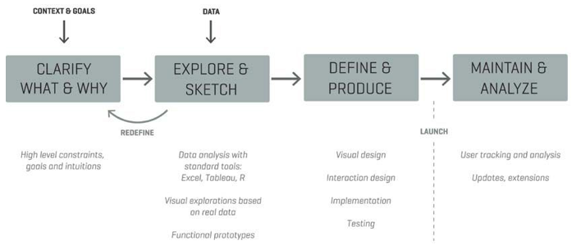
Another Process
From Moritz Stefaner:
Notes:
High level goals: what to achieve, does it accomplish these goals? When’s it done?
Get data in raw form – it’s hard to sketch graphical ideas without having some real data. Produce many sketches; sometimes it turns out people have different data than they think they do.
This flow is at a different resolution than Cairo

Slide 4
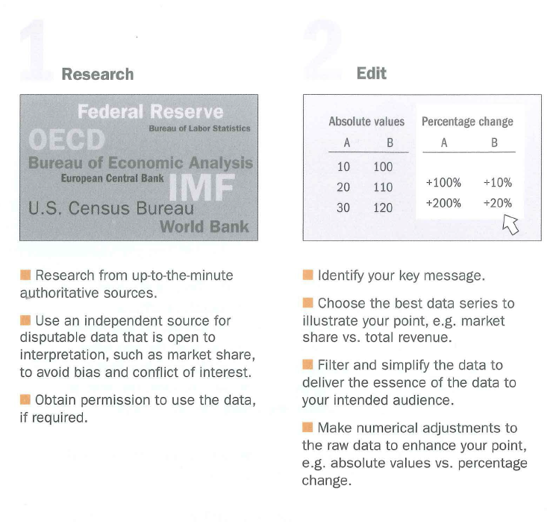
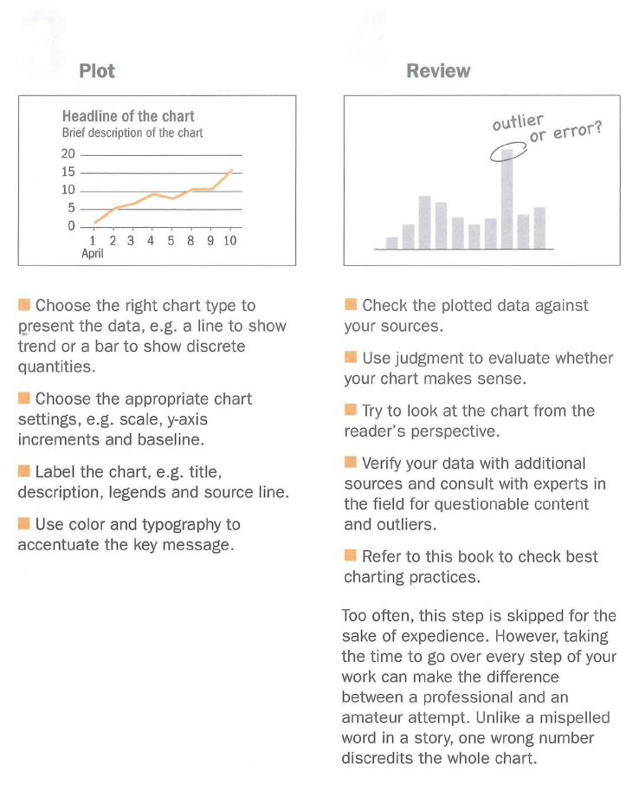
Another Process
Source: Wong. The WSJ Guide to Information Graphics.
Notes:
She starts with “research” on authoritative sources
Then “edit” – identifying key message, which is where cairo picks up
I like her editing of “review” – because it gets to the idea of “evaluation”, Stefaner calls this “maintain and analyze”

Slide 5
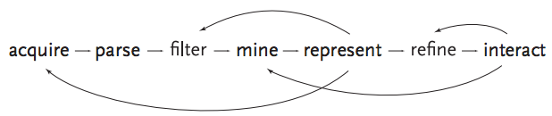
Another Process
From Ben Fry:
Notes:
I like this one because it has the feedback loops and gets to the idea that you’re iterating across this process.

Slide 6
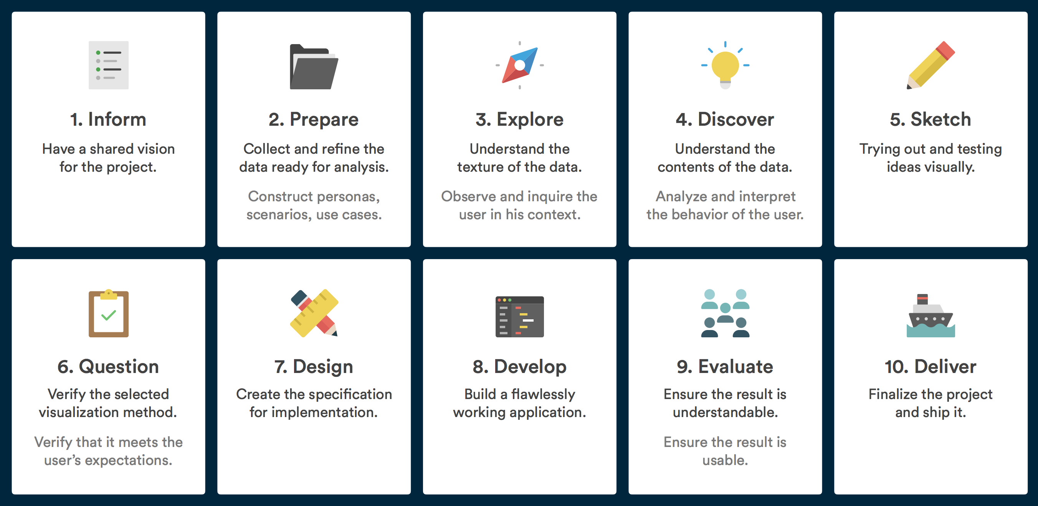
Another Process
- Benjamin Wiederkehr
Notes:
A different model for the visualization process from Wiederkehr also heavily emphasizes exploration and discovery before moving on to sketching and design.

Slide 7
What’s the “right” process?
I’m not sure there is one right way
These various methods are presented at different resolutions
But I do know you need to iterate back and forth between these ingredients, and get feedback along the way
Let’s look at examples in practice

Slide 8
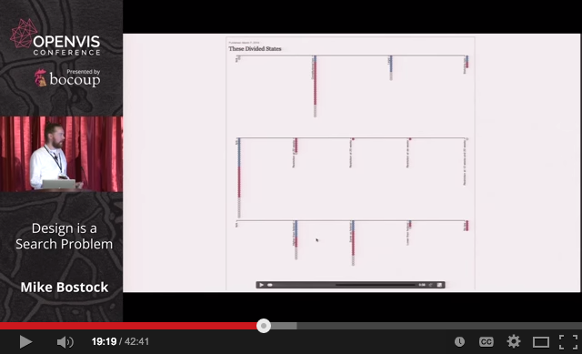
An Illustration of NYT Process
https://www.youtube.com/watch?v=fThhbt23SGM#t=1159
Notes:
https://www.youtube.com/watch?v=fThhbt23SGM#t=1159
All kinds of wild explorations; preview server for tracking history, good to share to get criticism and a fresh pair of eyes
But this is also just what would be considered “high fidelity” prototypes, with code. Before you get there often times you have lower fidelity mockups

Slide 9
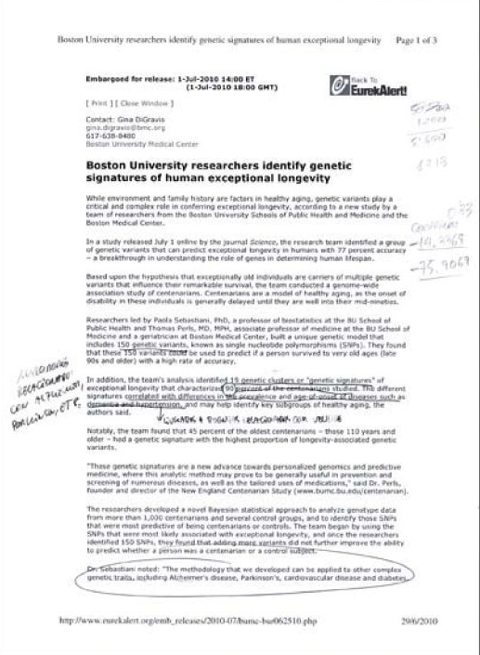
Notes:
Start with a strong focus, from a press release based on a research paper. This is along the same lines as ASGN 2 in terms of illustrating findings from a written text.

Slide 10
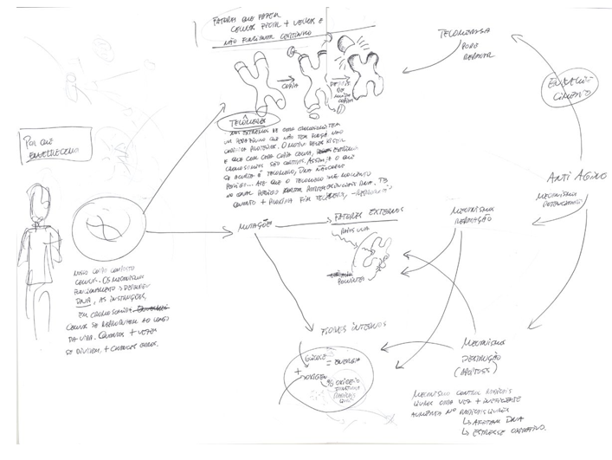
Notes:
You shouldn’t get on the computer until you have a rough idea of how it might all fit together. Sketches are very helpful

Slide 11
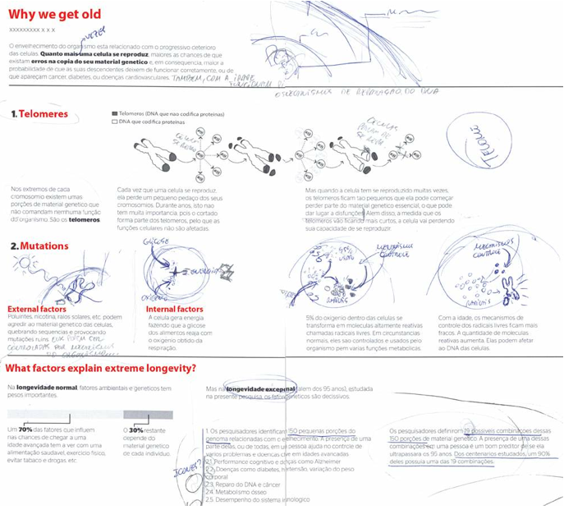
Notes:
Additional research and structure, you can start to see how the story fits together
No color really, it’s just about space, and about making sure things fit and flow.
You need to SKETCH before you move to doing stuff digitally … as it’s much higher effort to change things the more detailed you get.

Slide 12
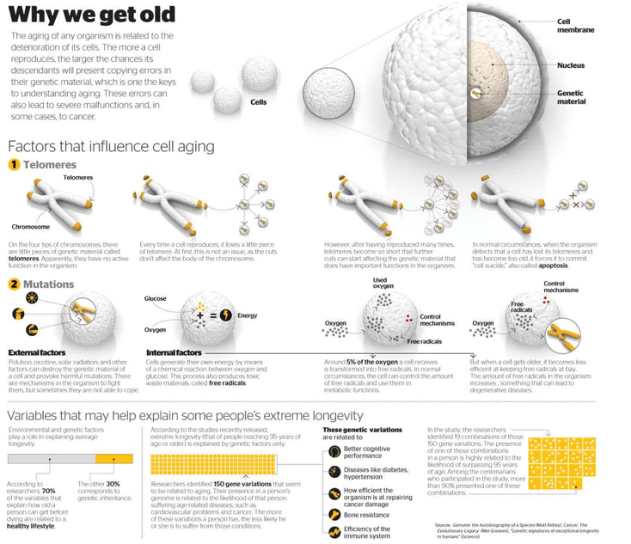
Notes:
The computerized layout and finished piece

Slide 13
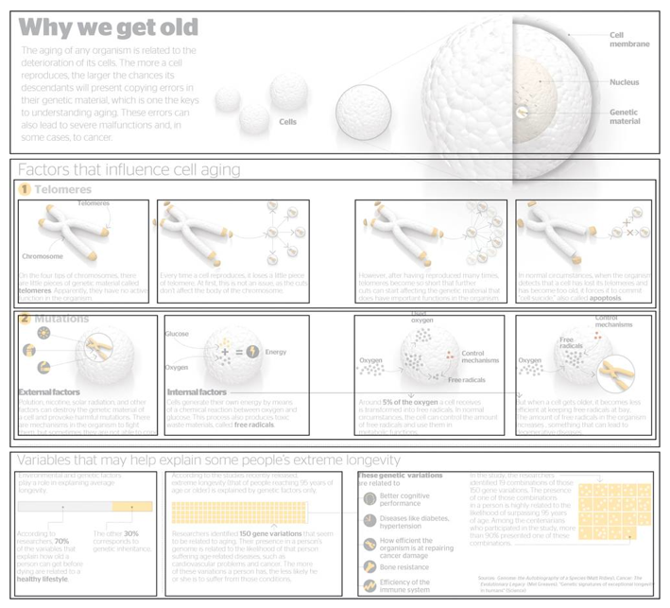
Notes:
Designing on a grid. You can see the rectangles where different size elements fit. This helps identify the structure and information hierarchy

Slide 14
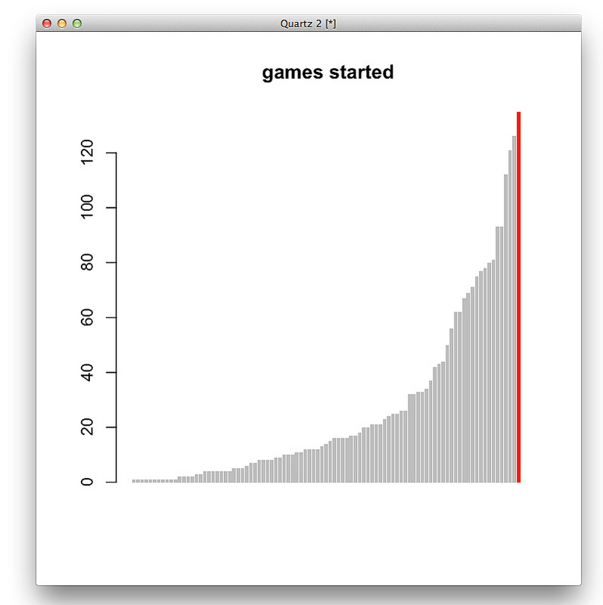
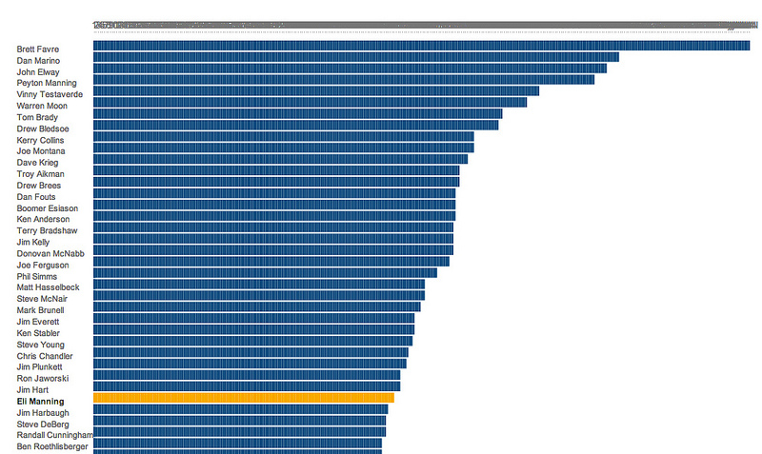
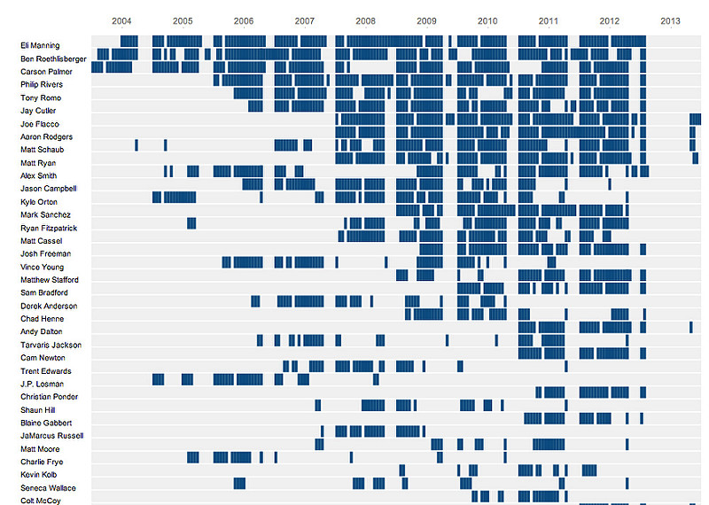
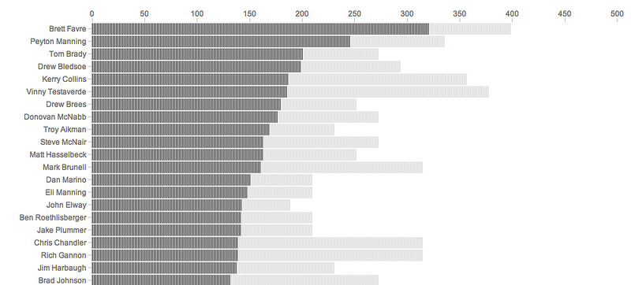
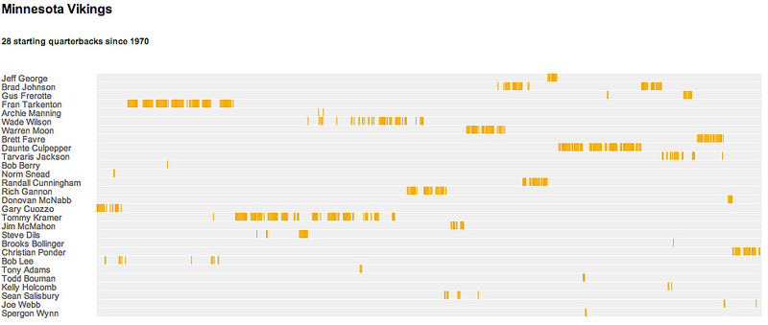
19th QB Timeline Sketches
http://kpq.github.io/chartsnthings/2013/09/19-sketches-of-quarterback-timelines.html
Notes:
http://kpq.github.io/chartsnthings/2013/09/19-sketches-of-quarterback-timelines.html
Another example of evolution of a visualization. Lots of different angles on data before the final is arrived at.

Slide 15
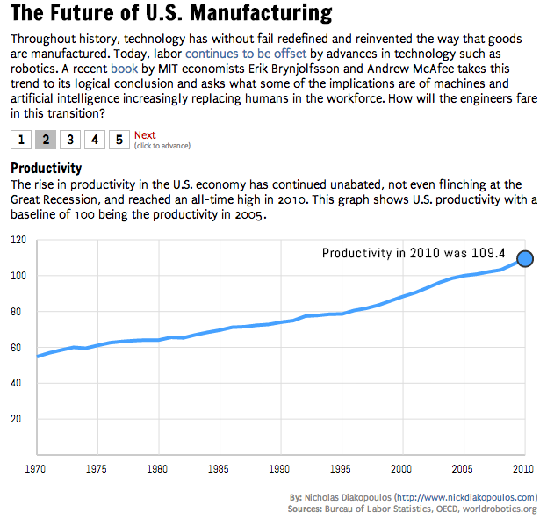
http://nad.webfactional.com/eiu/te/index.html
Notes:
Steppers for advancing the story, don’t need voice over or action, but use annotation to tell story, animation to emphasize, small multiples for comparison
Demo: http://nad.webfactional.com/eiu/te/index.html

Slide 16
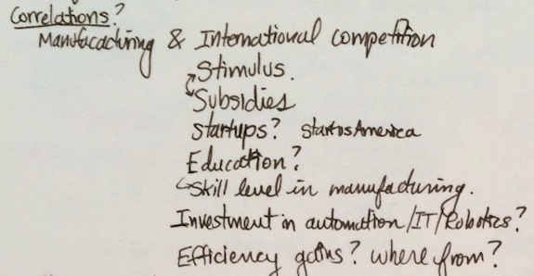
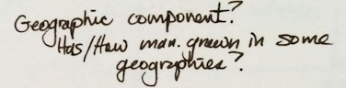
Analysis

Slide 17
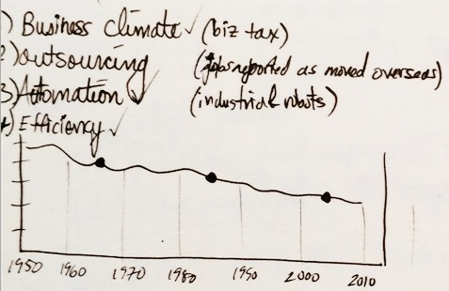
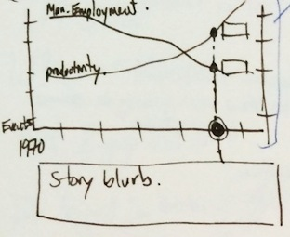
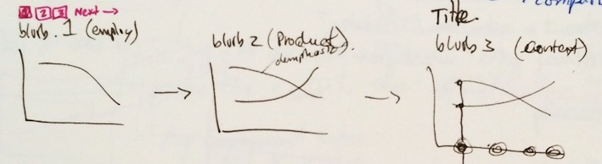
Story Points

Slide 18
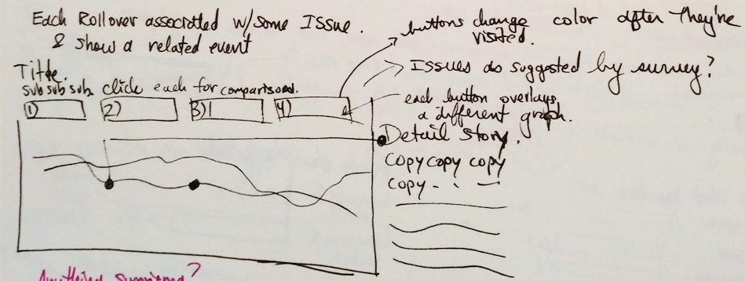
Exploring Different Layouts
Notes:
Iterating on information structure / architecture

Slide 19
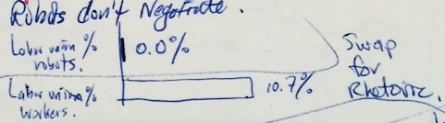
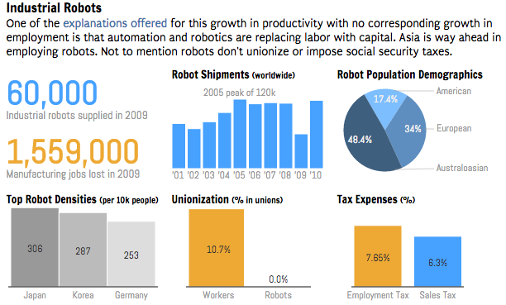
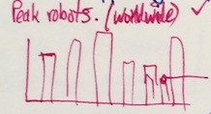
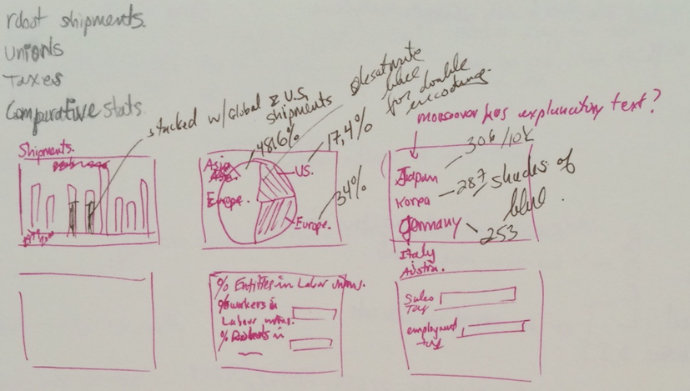
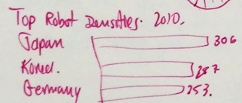
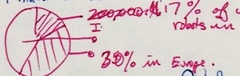
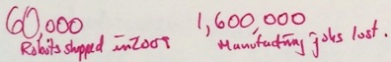
Notes:
Can see the sub elements and their layouts. Basic sketched of graphs. Some notes about interactivity
For this project moved from mockups to implementation b/c it was meant to be a quick and dirty project, whereas for other projects I produced many intermediate mockups to communicate ideas to team members

Slide 20
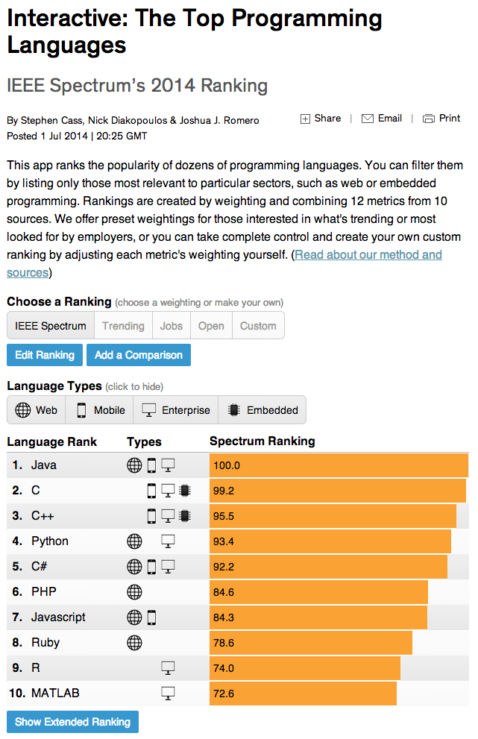
Notes:
Demo: http://spectrum.ieee.org/static/interactive-the-top-programming-languages

Slide 21
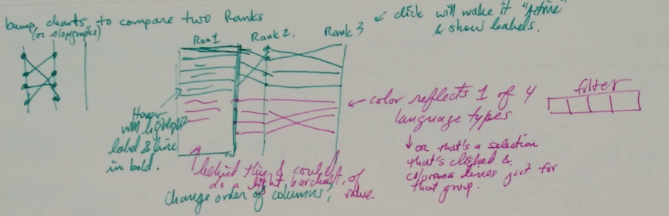
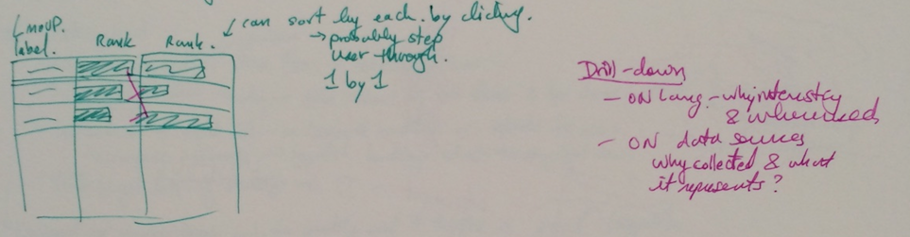
Sketches

Slide 22
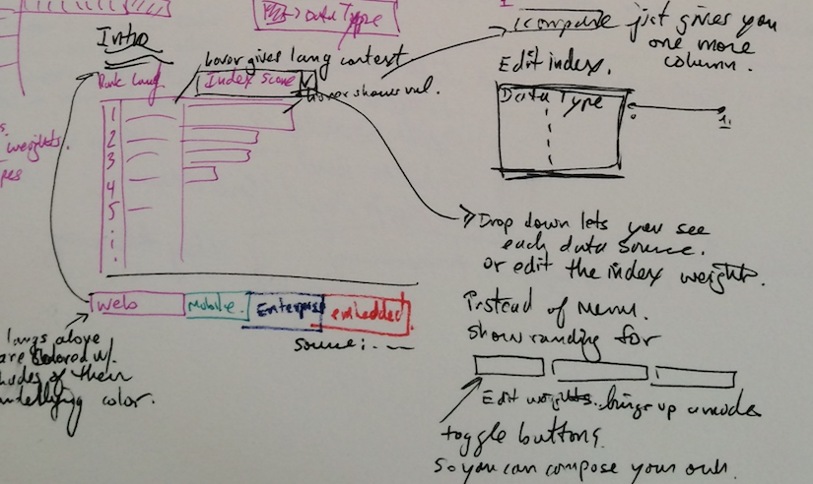

Slide 23
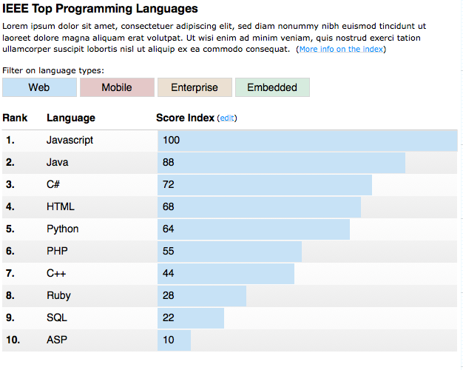

Slide 24
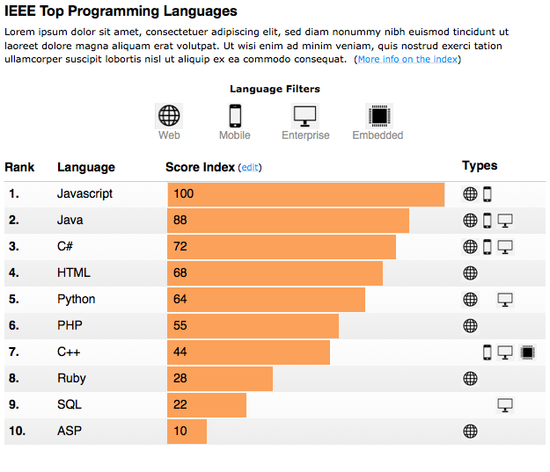

Slide 25
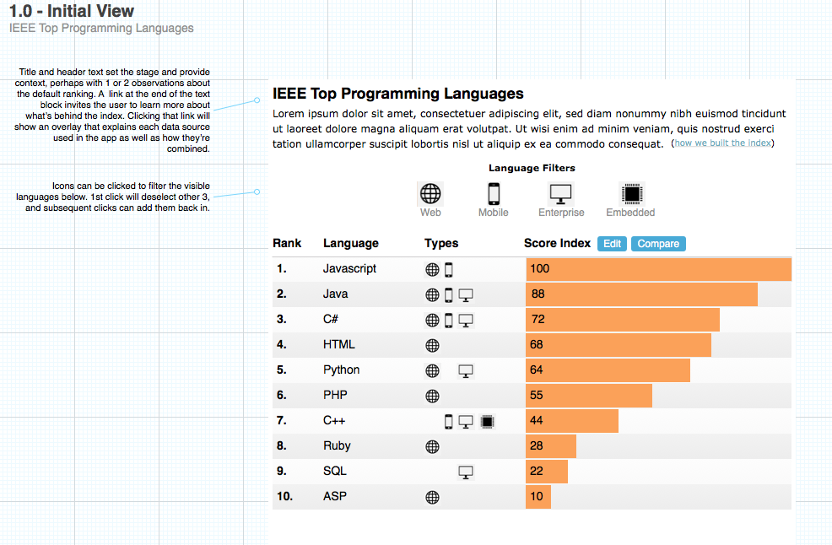
Notes:
Annotated wireframe – not real data.

Slide 26
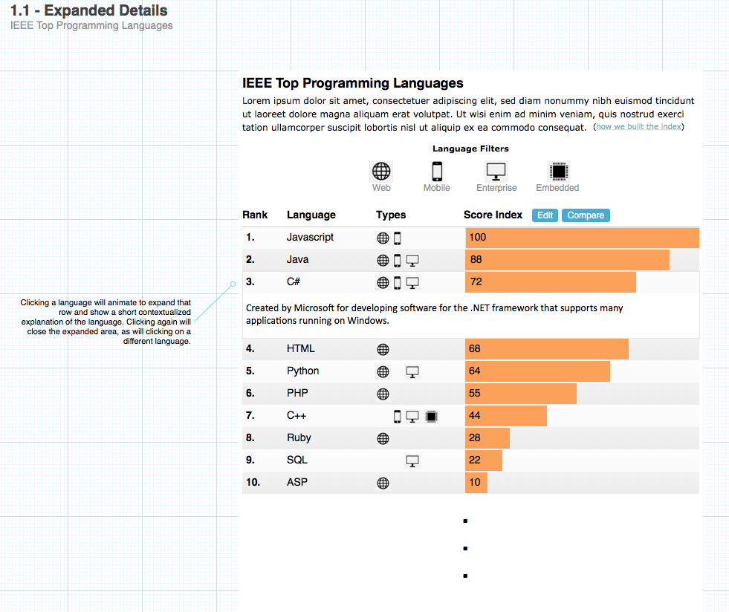
Notes:
Showing differnet views, like expanded details.

Slide 27
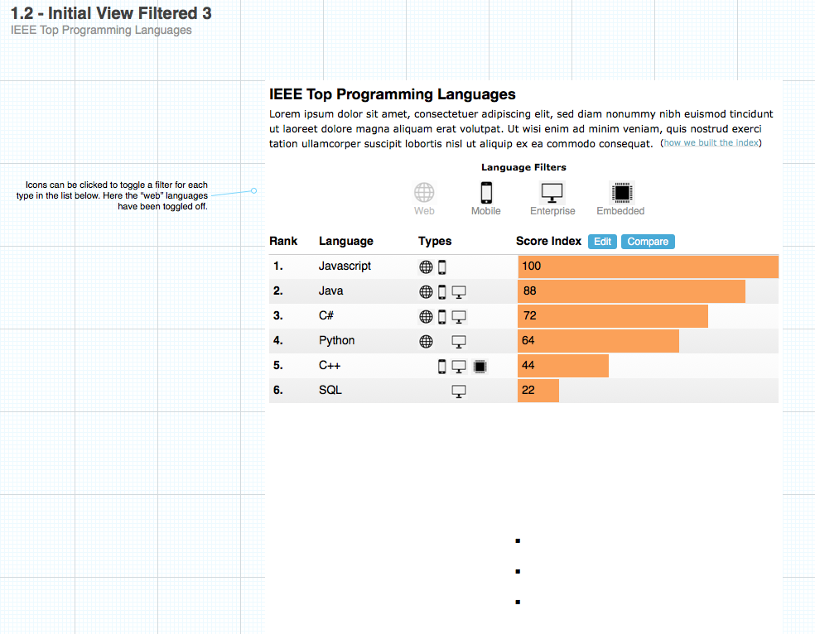

Slide 28
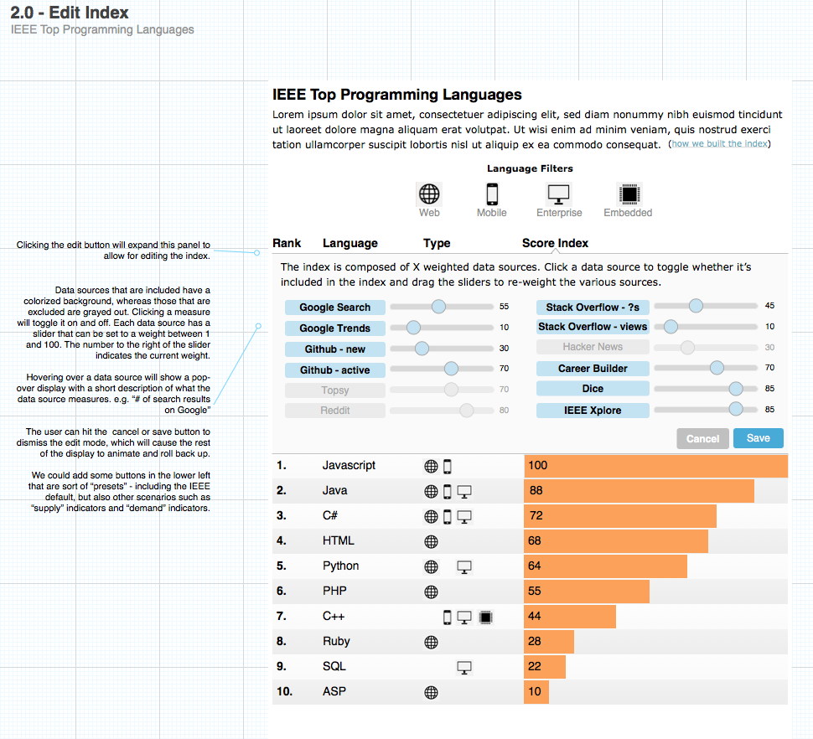

Slide 29
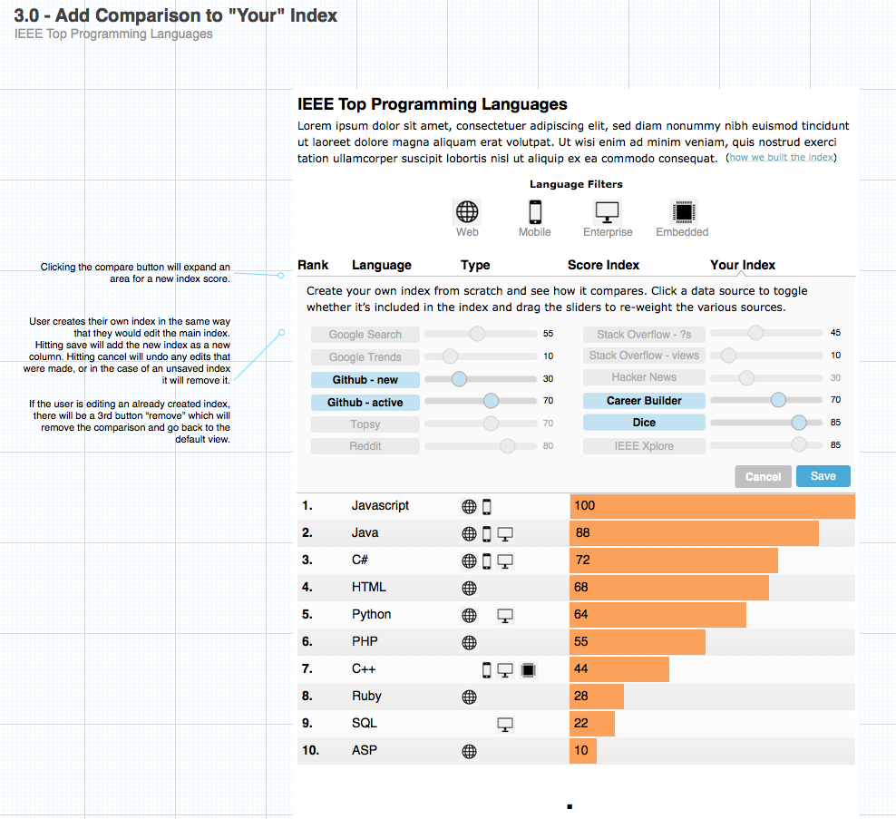

Slide 30
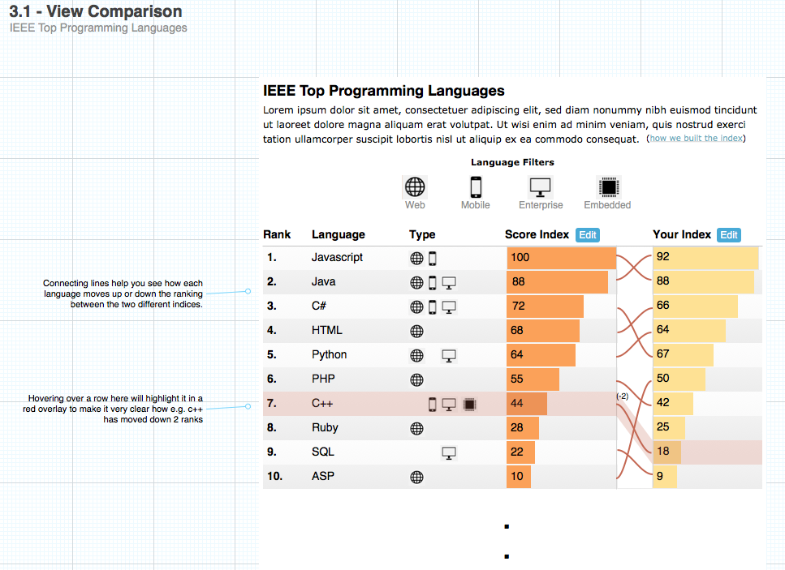
Notes:
One of the other tasks we wanted to try to support was comparison, to let people see how their own index compared.

Slide 31
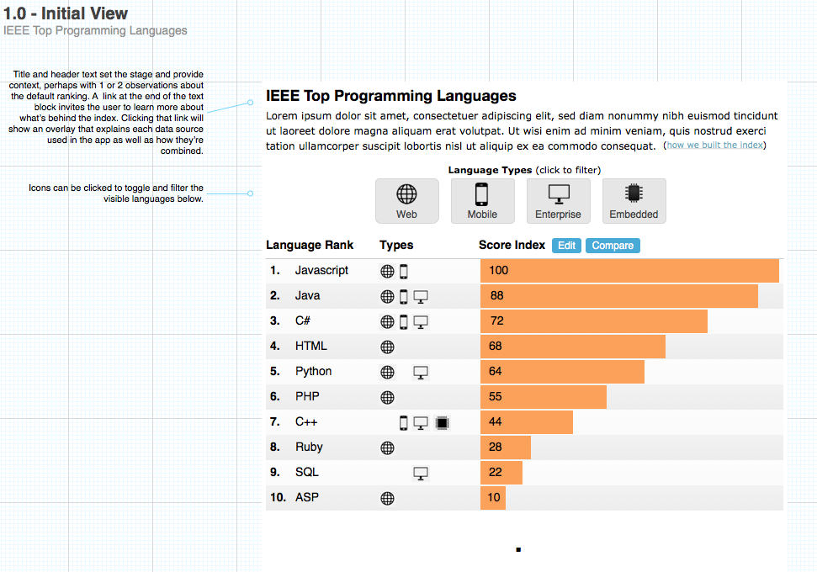

Slide 32
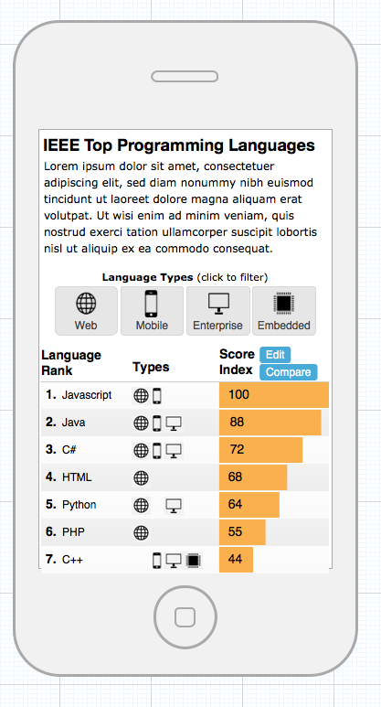

Slide 33
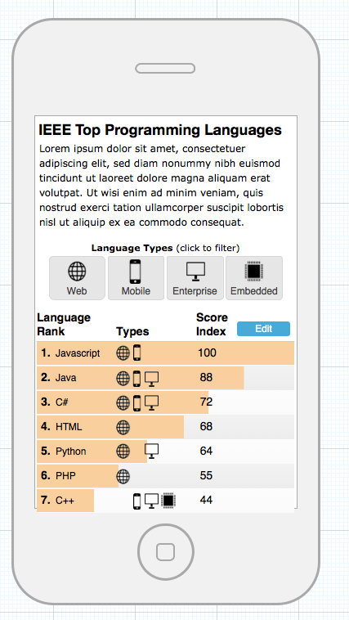
Notes:
Trying to make things fit.

Slide 34
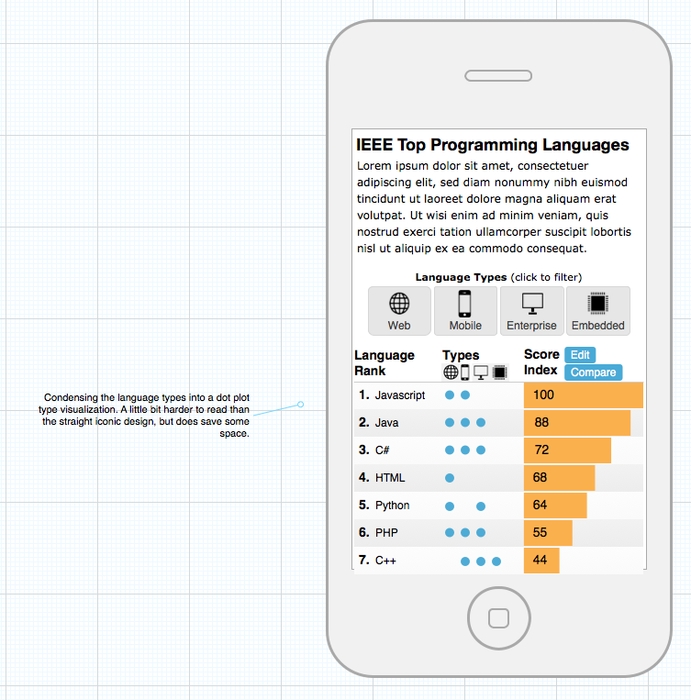

Slide 35
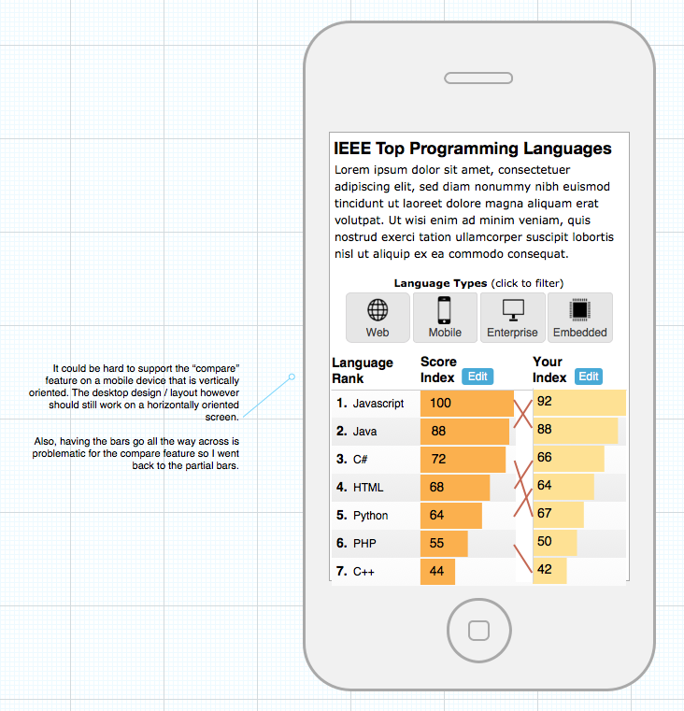

Slide 36
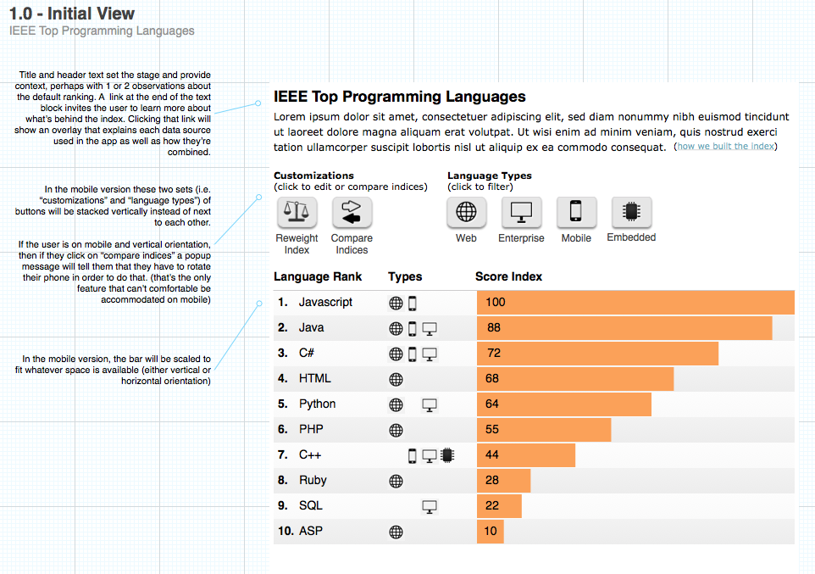

Slide 37
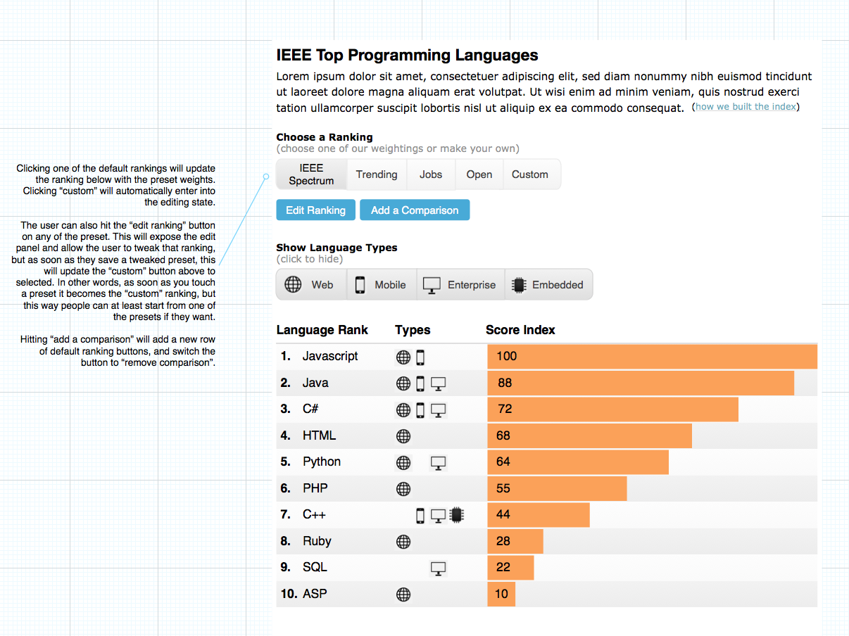

Slide 38
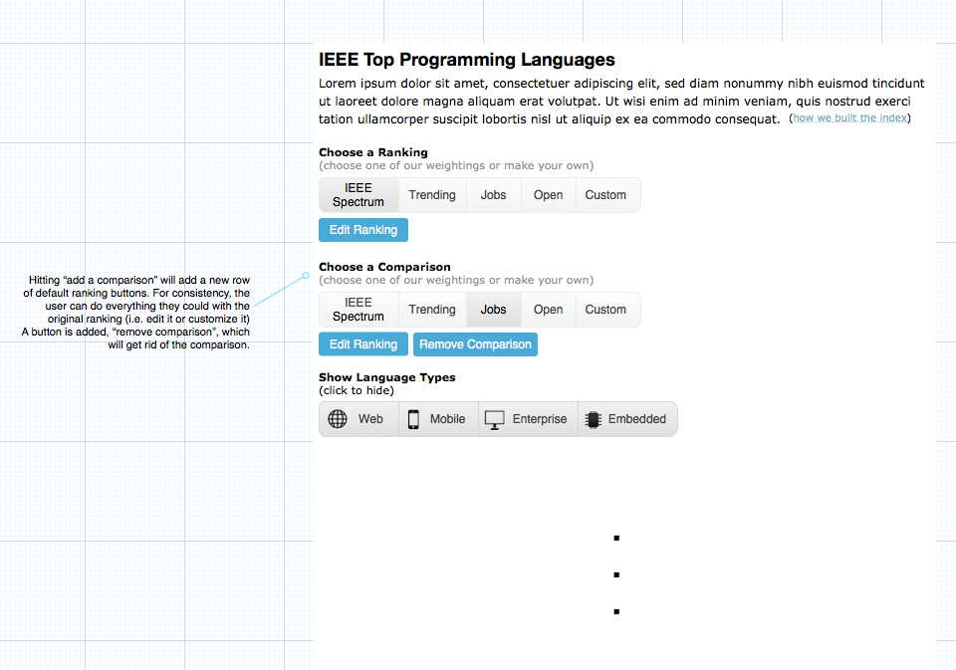

Slide 39
Design Artifacts
Annotated Sketches & Wireframes
Site Maps
Task Flows
(and task analyses)

Slide 40

Pill Photo Identification

Slide 41

Site Maps
Notes:
Way for structuring different views in your package. Trace user flows and paths and how they would want to navigate between different views and visualizations, and between different tasks.

Slide 42
Task Flows
Paths or processes taken
By user, by system, or both
How user interacts, and how system / UI responds
Should be able to tell a story of the user looking at task flow

Slide 43

Task Flow for Snapping
Notes:
What you can also incorporate is how information in the app will interact with the task. You can trace out a story or analytic flow between different aspects of a visualization. This could be useful for very directed kinds of visualization. Think about the visual queries that you would support along each step of the larger task?

Slide 44
Task Analysis
To produce a task flow you need to understand users’ objectives
Documentation
Observation
What info is employed, or needed?
Can analyze existing interfaces and then compare
Can be used to think through series of visual queries to design

Slide 45
Hierarchical Task Analysis
Make a cup of coffee
Grind coffee beans
Put filter in coffee maker (optional if metal filter)
Put 2 tablespoons ground coffee in filter
Fill coffee maker with water
Measure 8 Oz. of water
Pour water into coffee maker reservoir
Press “brew” on coffee maker
Wait 3 minutes
Fix cup
Pour brewed coffee into cup
Add milk (optional)
Add sugar (optional)

Slide 46

Task Analysis
Write down step by step how to do these tasks
Find how many gun imports (exports) are to Maryland
Determine the top states that import guns to Maryland
http://projects.propublica.org/graphics/atf-gun-traces
Notes:
15 minutes - Task analysis can also be used as an analytic device to understand how a visualization (or any interface) supports that task.
How might we redesign this graphic to better support? Network graphic?

Slide 47
Questions?

